Slide 1
Do You Have a Story in You?
Pamela Hart Vines
Valerie J. Mikles
RJ Crayton

Slide 2
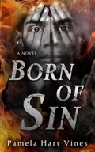
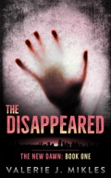
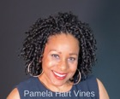
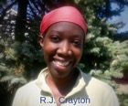
Introducing Your Authors
Pamela Hart Vines
Valerie J. Mikles
R J Crayton

Slide 3
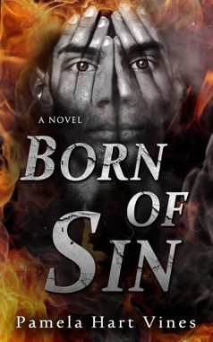
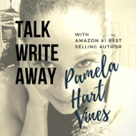
About Pamela
US Army Lt. Colonel (Retired)
Amazon #1 Best Selling Author
Born of Sin (Dec 2015)
Born by Fire (Feb 2019)
The Last Born (Dec 2019)
Public Relations Strategist
Troop Public Relations, LLC
Chapter Leader (AWE-PG)
Filmmaker
Vines Film (A Division of Troop PR)
Book Trailers
Corporate, Social Cause & Documentary
www.trooppr.com
www.pamelahartvines.com
Pamela H Vines / YouTube

Slide 4
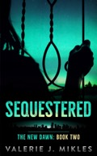
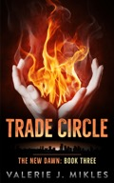
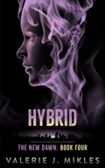
About Valerie
Astronomer / Science Management Support
Dancer/ Choreographer
Screenwriter / Producer
http://aces-sitcom.com
Author
The New Dawn series
SIGN UP FOR MY NEWSLETTER
http://www.valeriejmikles.com
BeanyThing - be all the things!

Slide 5
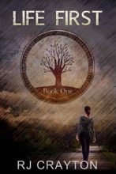
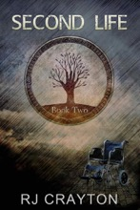
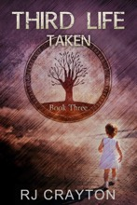
About RJ
www.RJCrayton.com
Author of three fiction book series
Author of the Self-Publishing Road Map
Former reporter, editor
Contributor, Indies Unlimited

Slide 6
Agenda
Inspiration and Writing - Pamela
The Editing Process - Valerie
Publishing - Rasheeda
Q & A - All

Slide 7
Inspiration and Writing
Pamela Hart Vines

Slide 8
Outline
Finding and Keeping the Inspiration
Resources
A Writer’s Life
Your Author Platform
Six-Month Countdown Before You Launch
www.pamelahartvines.com
@pamelahartvines

Slide 9
Finding Inspiration
Read
Listen
Talk
Write
Google
Play
www.pamelahartvines.com
@pamelahartvines

Slide 10
Resources: Mind | Body | Soul
Devour Inspirational | Informative References
On Writing - Stephen King
Daily Rituals (How Artists Work) - Mark Curry
Dialogue - Robert McKee
Find A Writing Community
Recognize Stagnancy vs. Growth
www.pamelahartvines.com
@pamelahartvines

Slide 11
A Writer’s Life
Consistency and Rituals
Word Count vs. Set Length of Time
Plotting vs. Flying by the Seat-of-Your-Pants
www.pamelahartvines.com
@pamelahartvines

Slide 12
Your Author Platform
What is it?
Your visibility as an Author
Is it Important?
Umm--, yeah!
Where to begin?
Where you’re strongest
www.pamelahartvines.com
@pamelahartvines

Slide 13
Six-Month Countdown : Plan | Position | Promote
Month 6: Set Goals
Month 5: Branding
Month 4: Build a Team
Month 3: Promote
Month 2: Pre-Sell
One Month Away: Repeat; Repeat; Launch; Repeat
www.pamelahartvines.com
@pamelahartvines

Slide 14
Final tips
Jot it down or lose it forever
Know your why
Write daily
Get better or get help
www.pamelahartvines.com
@pamelahartvines

Slide 15
The Editing Process
Valerie J. Mikles
valeriejmikles.com

Slide 16
Outline
Your first edit
The editing process
Going outside yourself
Beta readers
Editors
Keeping on task
Final tips
http://www.valeriejmikles.com

Slide 17
The vomit draft
“Getting it right is not the point as long as you create”
Beware getting caught in a cycle of revising the beginning and never making it to the end
Are you a plotter or pantser?
I plot the series and pants the books…
http://www.valeriejmikles.com

Slide 18
The first edit
How are you going to edit?
Spreadsheet timeline (my method)
Word - track changes
Print and red ink
Read out loud
Focus on the big picture
Do the ideas flow?
Are there big things that need to be fixed?
What is missing? What can I cut?
http://www.valeriejmikles.com

Slide 19
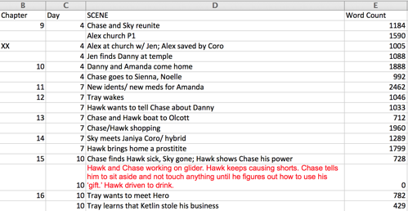
Creating a timeline
Chapter, Day, Brief Scene Description, Word Count, (POV?)
Does the timeline make sense?
Are any of the chapters or scenes too long?
If you’re reordering or deleting scenes, are there any continuity issues that need to be addressed?
I usually create this between the first draft and first major rewrite.
This is a visual organization tool. Some people use index cards taped to the wall. Some people use novel-writing software. There is no wrong way to keep track of information. You find what works for you.
http://www.valeriejmikles.com

Slide 20
Making a property bible
Make a spreadsheet
Tab 1: Character List
Full name, nickname
This is not for character bios; this is for spelling consistency
Tab 2: Place Names
Cities, towns, planets, or any location that requires capitalization
Tab 3: Proper Nouns
Terms that are specific to your books (e.g., languages, species, spaceships)
In my book, the Disappeared refers to a people group and is capitalized.
Tab 4: Style Sheet
Words that you made up or any word you feel you need to mark for consistency. (Example on next slide)
http://www.valeriejmikles.com

Slide 21
Read, rewrite, polish
Can you make it better?
Yes, I have a list
No, I have questions
http://www.valeriejmikles.com
Edit
Get a beta reader

Slide 22
A beta reader is not an editor
Ask specific questions, get specific answers
What worked best?
What didn’t work?
Give them a time limit
Find more than one if you can
Give them permission to be brutal
Give yourself time to digest and respond (it’s okay to cry)
Everyone has an opinion. Remember that you are the writer and this is your story
http://www.valeriejmikles.com

Slide 23
What kind of editing can you afford?
Developmental editing - fix the content
Manuscript editing - fix the sentences
Copyediting - fix the words
Proofreading - sanity check
http://www.valeriejmikles.com

Slide 24
My editing process
First draft - Fastest was 2 months, slowest was 12 months. (Note: I never had a deadline.)
Self-edit - 2-4 months (depends on complexity of rewrite required)
Beta reader - 1 month for them to complete task and give my brain a break
Respond to beta comments, and rewrite - 1-2 months
First round with editor - 1 month for them to complete task
Respond to edits, rewrite/revise - 1-2 months
Second round with editor - 3-4 weeks
Final touch-ups - 3-4 weeks
Proofread
My editor does edits in line, and then a 3-4 page letter just about the content and what worked/didn’t. This is a bit of a hybrid between the developmental edit and manuscript edit
http://www.valeriejmikles.com

Slide 25
That time I made a 5 year plan
http://www.valeriejmikles.com

Slide 26
Final tips
Find what works for you
Set your timeline and stick to it, but remember that schedules can also be edited
Take your time, give yourself a break
Aim for completion not perfection
http://www.valeriejmikles.com

Slide 27
Publishing
RJ Crayton

Slide 28
Outline
Definitions
Pros & Cons
Book Responsibility
Readying Your Book for Publishing
Editing/formatting
Covers
Publishing
Marketing

Slide 29
Definitions
Traditional Publishing
Agent, Publisher, Year+ timeline
Self-Publishing
Author takes full responsibility, shorter timeline
Vanity Publishing
Author pays company
Hybrid Publishing
Combination of self/traditional

Slide 30
Pros & Cons of Self-Publishing
 | Self-Publishing | Traditional Publishing
Advance | None | $3,500 (typical)
Royalties | 35-70% | 2-17%
Rights | Total | Few or None
Control | Total | Little or None

Slide 31
Pros & Cons of Self-Publishing
 | Self-Publishing | Traditional Publishing
Contracts | None | Yes (Binding)
Bookstores | Difficult | 2-6 weeks
Speed | Immediate | 1 year
Workload | Heavy | Light

Slide 32
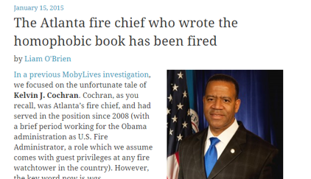
You are Responsible for Your Book
Does book violate work code of conduct?
Does book expose you to liability?
Product liability
Memoir

Slide 33
Readying Your Book
Edited Manuscript
Formatted Manuscript
Ebook
Print
Blurb

Slide 34
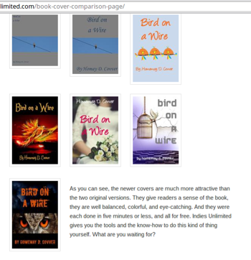
Covers - DIY
Make it Yourself
Images from Pixabay, Wiki Commons, stock photo sites
PhotoShop, Gimp, or Paint for design

Slide 35
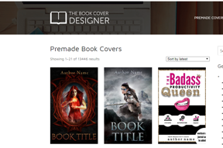
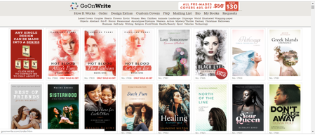
Covers - Get a Professional
Order a custom cover
Buy a pre-made cover

Slide 36
Publish - ebooks
Amazon
Barnes & Noble
Kobo
Apple
Google Play
Aggregators
Draft2Digital
Smashwords

Slide 37
Publish - Print books
Amazon KDP (formerly CreateSpace)
IngramSpark

Slide 38
Marketing
Ebook Discount Sites
Google AdSense
Amazon Ads
Newsletters
Social Media

Slide 39
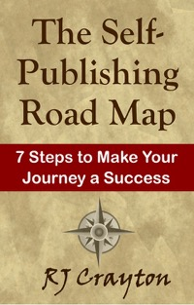
Publishing Review
Decide your publishing route
Get your book ready
Publish
Market

Slide 40
Q & A
Sign up for our newsletters!
www.pamelahartvines.com
www.valeriejmikles.com
www.rjcrayton.com

Slide 41
Sign Up to Get More Info!
Beta Reading Worksheet
Questions to help hone in on issues involving opening scenes, characterization, plot & conflict, pacing, and craft
Publishing Resources Sheet
Lists that include self-publishing websites, ebook formatting guides, beta reader tips, editing sites, cover sites, book review sites, book advertising sites, useful blogs, and useful books

